Slide 1
Introduction to Network Defense
INFSCI 1075: Network Security – Spring 2013
Amir Masoumzadeh

Slide 2
Outline
Network defense and security process
Assessment
Protection
Detection
Response

Slide 3
Defense
What does network security mean in terms of defense?
Security is the process of maintaining an acceptable level of perceived risk
Note acceptable, not completely eliminating risk
Remember: cost vs. benefit
It is a continual process
Security must continually be checked and updated
It is an uncertain process
You never really know how secure you are

Slide 4
Security Process
Just as attacks have general stages (or processes), so does defense
Also, like attacks, there is no one de-facto standard
The security process involves several steps
Assessment
Protection
Detection
Response

Slide 5
Security Process: Assessment
Preparation for the remaining three stages
Assessment often deals with the following processes
Business evaluation of security
Cost vs. Benefit
Technical evaluation of security
Current status and feasibility
Policy and procedure development
Laws and regulations
What security measures a business must use
Other managerial concerns
Team assembly, budgeting, support, etc.

Slide 6
Risk Analysis
A critical part of the assessment stage
Types
Qualitative – enumerating attacks and their impacts
Consideration of organizational goals, asset value, threats, vulnerabilities and effectiveness of current safeguards
Subjective in nature measured by “High, Medium, or Low” values given by staff/experts, etc.
Quantitative – estimating the likelihood of attacks
Precise measurement of risks based on modeling and analysis together with historical data
Assigns objective numeric values to components of risk analysis and potential loss

Slide 7
Risk Analysis
Includes
Asset identification and valuation
Threat definition
Threat vector – Information about a threat, its origin and the target assets
Likelihood and impact analysis
Basic risk analysis assumes that threats are equally likely and merely identifies assets
A more advanced analysis values assets, classifies threats, and analyzes the threat on each asset
Surveys such as CSI – e.g., internal threats usually amount to 70-80%
Take a look at CSI survey 2010/2011 and Sophos report 2013 (available on CourseWeb)

Slide 8
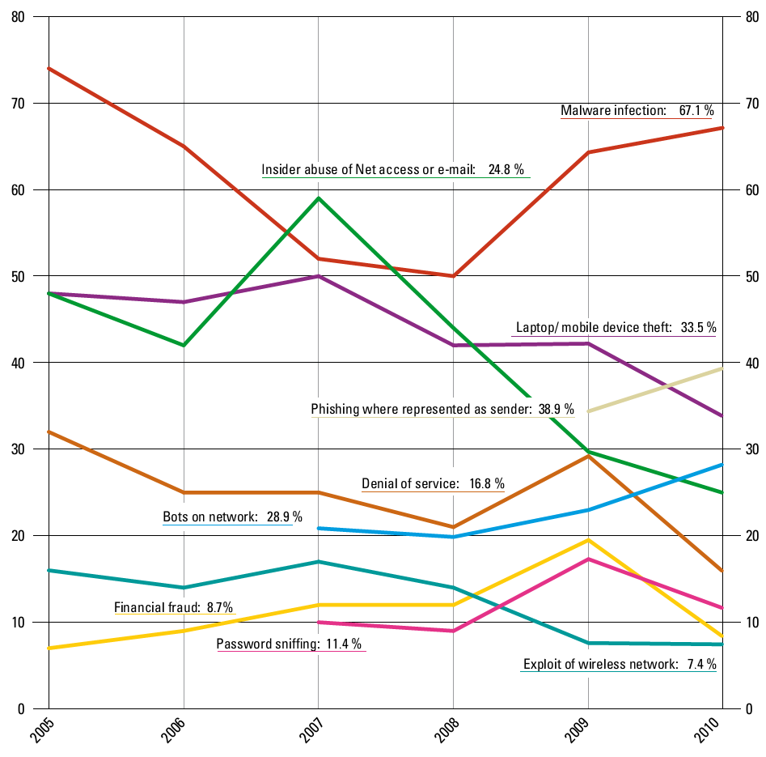
CSI 2010/2011: Types of attacks by percentage of respondents

Slide 9
Risk Analysis
Once risk has been clearly defined, it dictates
What needs to be protected
What is threatened? What is vulnerable? What is of value?
What the priorities of assets / protections are
What is most threatened or vulnerable? What is of most value?
What protections should be used
What measures counter the vulnerabilities?
How much is OK to spend on preventative measures?
You can think of protections as decreasing the risk

Slide 10
Security Process: Protection
Involves the realization of information gained and plans made in the assessment stage
Drafting of policies and procedures
Including the training of employees, etc.
Deploying software and hardware protections
Firewalls, IDS/IPS
Password policies, access control policies, etc.
Monitoring and logging
Patching
One key assumption that security personnel should make is that protections will eventually fail

Slide 11
Security Process: Detection
Assumes that assessment and protection will fail
Aims at detecting attacks once in progress
Security breaches are hard to prevent (zero day exploits, user vulnerabilities, etc.)
Detection ensures that when protections fail, an organization knows in order to respond
Assumes that assessment and protection have been conducted properly
Assumes continual monitoring and assessment of existing protections

Slide 12
Security Process: Response
Validates the findings of detection
The response stage may include
Removing the attacker
Or “jailing” the attacker
Or even just ignoring him/her
Preventing damage
Or recovering from it
Patching holes and closing backdoors
Documenting evidence
May include taking machines offline
May have to trade off with rapid recovery
Prosecuting the attacker

Slide 13
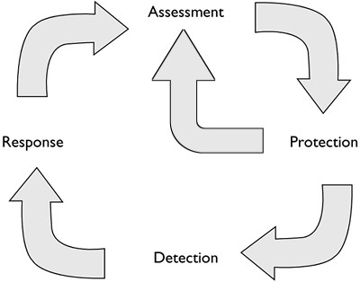
Security Process Cycle
A repeating and evolving process

Slide 14
Defense Models
There is always a defense model, e.g.,
Perimeter security model if firewall is the primary defense mechanism
Layered model if multiple defense mechanisms are employed
Effective security infrastructure requires understanding the defense model as well as trust definitions
What is fully trusted?
What is partially trusted?
What is not trusted?

Slide 15
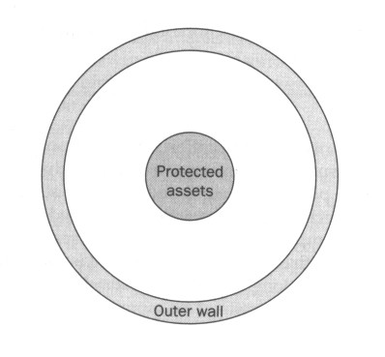
Lollipop Model of Defense
Most common model
Focuses on perimeter security
Protection is concentrated on keeping the outsider out
Has many limitations
Once attacker penetrated the outside wall, no other defense measures
Does not provide different levels of security appropriate to the assets
i.e., it protects everything equally against everything
Does not protect against insider attacks

Slide 16
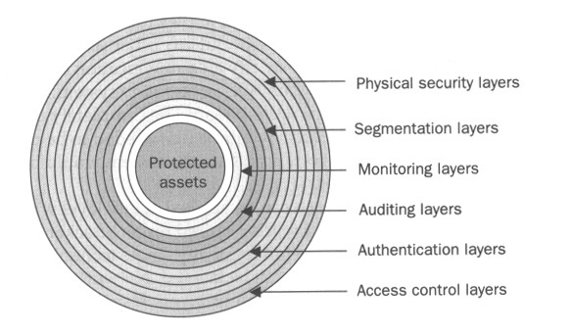
Onion Model od Defense
Defense is deployed in many layers
Does not rely on one, single layer of defense
Much harder to predict and penetrate than lollipop model
Can be achieved in many ways
Segmenting network (based on access and need)
Defining zones of trust
Protections at various levels
Network
System
personal firewall software, system access controls, etc.
Application
Multi-factor authentication, authorization levels, etc.

